Slide 1


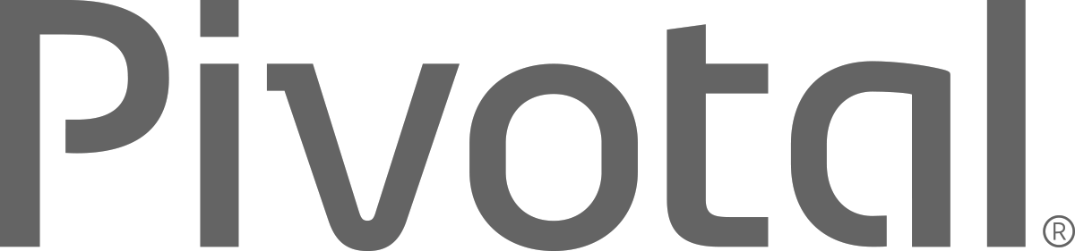
Cloud Native Platforms & Pivotal Cloud Foundry
Workshop Introduction
Ben Bertka / Platform Architect
bbertka@pivotal.io
Notes:
Cloud Native is a term that recognizes that getting software to work in the cloud requires a broad set of components that work together. It also requires an architecture that departs from traditional enterprise application design, such as ‘Microservies’.
I want to talk to you about cloud native applications, and bringing microservice architectures into production in the enterprise.

Slide 2
Agenda
Changing Development Models
Microservices in the Enterprise
Cloud Native Application Platforms
Pivotal Cloud Foundry
Notes:
I wanted to go over some of these emerging development models and
how tech companies have been successful in moving to these highly composable, resilient application architectures that we’re referring to as cloud native applications.
I want to show you what kind of platform tools the leading tech companies had to build.
And how these new designs are really hitting a lot of enterprises, companies that don’t depend on software directly.
We also want to showcase how these projects work together with a demo of a microservice-based Java app, built with Spring Boot and Netflix OSS projects
Before we turn it over to discussion

Slide 3


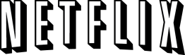
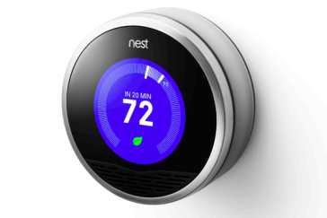

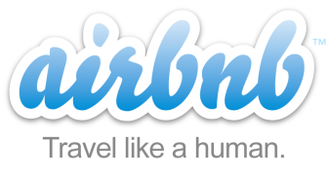
Companies are Disrupting Industries with Modern Technology and Agile Development Strategy
$3.5B valuation
Financial Services
$19.5B valuation
Transportation
$20B valuation
Entertainment
$3.5B valuation
Travel & Hospitality
$3.2B Acquisition by Google
Home Automation
$26B Evaluation
Automotive
Notes:
if a company, in any industry, can't do software well, the will get left in the dust. Look at these examples...
Uber is the taxi copmpany with no taxies
Airbnd is the hotel company with no hotels
Square is the POS service provider with no professional services IT
Hows you business going to compete with lean startup companies dominating the market?

Slide 4

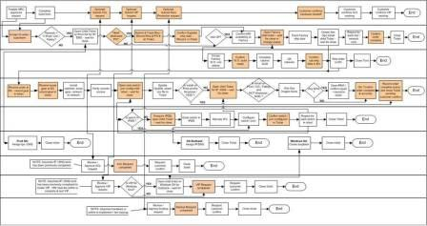

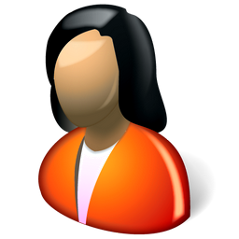
Monolithic Applications Drive Complex, Manual Deploys & Waterfall Release Cycles
Developer
Operator
Notes:
We’re working with customers like Comcast and Lockheed Martin who have been struggling to ship software faster. Both in terms of new projects and implementing these modern, DevOps-friendly environments that can handle real continuous delivery.
If you’re doing big project with ‘agile waterfall’ where you use agile development with weekly sprints but have a huge manual process to actually ship every 3-9months.
Disconnect between dev and ops. Throw the code over the wall
… and do it all over again from Dev → Test → Prod on any infrastructure

Slide 5
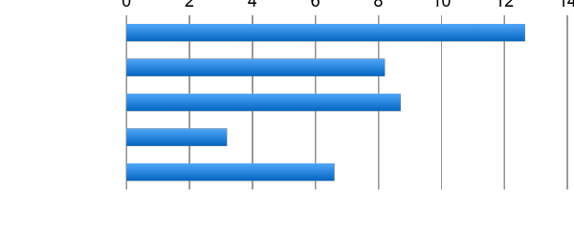
Productivity: Software developers spend too much time on administration
0
2
4
6
8
10
12
14
Design and Coding
Brainstorming
Administrative Tasks
Managing Environments
Waiting for Test/Build
Task Breakdown
Average Hours / Week
Sources: “Electric Cloud LinkedIn Survey to software developers”
Notes:
Traditional CI/CD deployments setup with custom servers means that each app instance requires individual configuration and secured. This kicks off a whole set of checks and balances from your ops team. You have ticket-based manual provisioning. When you go to push an update, it’s too complex to automate and test automatically, so every update requires a sequence of manual steps and checks. You
As you can see in this survey of over a thousand developers, devs estimate that they spend a huge amount of time on administration and environment managing their environment, including 20% of their time waiting. So there are some obvious issues with
http://readwrite.com/2013/04/25/how-software-developers-really-spend-their-time

Slide 6
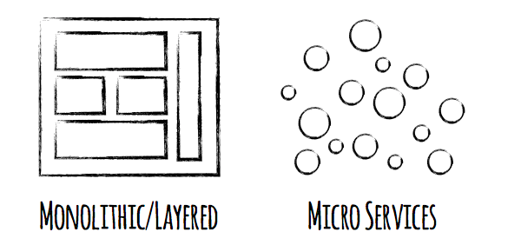
Applications Must Now be Architected as Scalable, Resilient, and Easy to Manage Systems
Tightly Coupled
Services
Loosely Coupled
Services
Notes:
Enterprise companies in finance and telco industries are embracing microservice and cloud-native models.
There are new architectures emerging atop these lightweight app servers to address the scale, speed and safety: new ways of tackling cloud scale and speed to market. Microservices has emerged from the internet giants as such an alternative: a change in culture, organization structure and technology that allows teams to work more independently, and increase velocity. It’s a key part of cloud-native applications, which we’ll talk about shortly.
Microservices are both a cultural and organizational change as a change in how we design and implement systems.

Slide 7
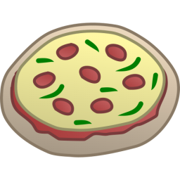
One-Size-Fits-All Methodologies have become an Anti-pattern to the Business
X
HTML
Java
Script
MVC
X
Service
Service
Data Access
Monolithic Application
> 2 Pizzas Per Project = Too Many Pizzas

Slide 8



Agile, Disruptive Companies Use Non-traditional, Modular Approaches to Software Systems
Microservice Architecture
Relational
DB
Key/Value
Store
AQMP
…..........
Shared
DB
REST
REST
DB Service
Caching Service
Messaging Service
Two Pizzas Per Microservice = Manageable!

Slide 9

What is Cloud Native?
A term that recognizes that getting software to work in the cloud requires a broad set of components that work together.
It also requires an architecture that departs from traditional enterprise application design, such as ‘Microservices’.
Notes:
http://www.informationweek.com/cloud/platform-as-a-service/cloud-native-what-it-means-why-it-matters/d/d-id/1321539

Slide 10
The Power of a Cloud Native Platform
$
Business Value,
Agility & Cost Savings
Traditional IT
IaaS
PaaS
You Manage
Applications
You Manage
Applications
Applications
Data
Data
Data
Runtime
Runtime
You Manage
Runtime
Runtime
Middleware
Middleware
Middleware
Middleware
Pivotal CF
+
Choice of IaaS
O/S
O/S
O/S
O/S
Virtualization
Virtualization
Virtualization
Virtualization
Virtualization
Servers
IaaS
Servers
Servers
Servers
Servers
Storage
Storage
Storage
Storage
Storage
Networking
Networking
Networking
Networking
Networking

Slide 11

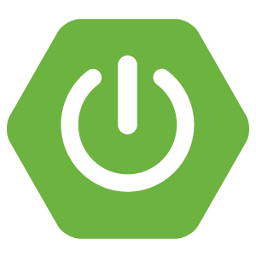
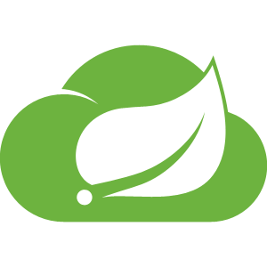


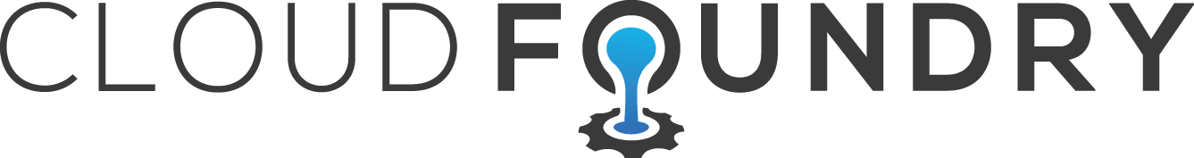
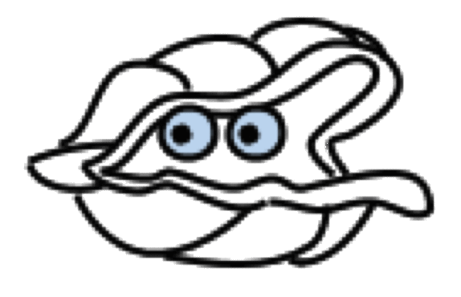
Cloud Native Platform Overview
Application Framework
Language framework for microservice-based architectures including components for service discovery, metrics and circuit breakers.
Spring
Boot
Spring
Cloud
Dev
Contract: 12 Factor Application
Platform Runtime
Application container runtime with attachable backing services, automated CI/CD, routing, health management and logging.
Pivotal
Dev
Ops
Cloud Foundry
Contract: BOSH Release
Infrastructure Automation
A single deployment API for provisioning for bit-for-bit, consistent, self-healing deployments across any private or public cloud.
Pivotal
Ops
BOSH
Cloud Foundry
Notes:
An opinionated set of frameworks and tools for delivering distributed applications.
We have been working ‘Cloud native application platform in a box’. PCF is the 1st and only cloud native vendor available today.
The differentiator are these contracts between your application and the runtime, and between the runtime and the infrastructure.
12 Factor application design lets us built applications that are suitable for CI/CD.

Slide 12
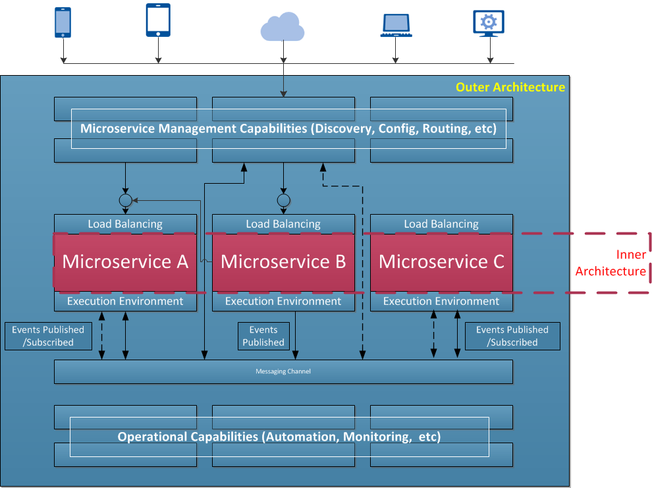
The Role of Cloud Native Platforms in Microservices
“The hardest part of building microservices is in the outer architecture (All of the blue boxed components).”
“Easiest part of the microservices is in the inner architecture. The architecture of an individual microservice.”
Cloud Native platforms provide the outer architecture
Notes:
This slide is from T-Mobile – it is from a POC under Steve Hull’s group evaluating microservice architectures on public cloud infrastructure.

Slide 13








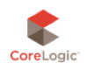






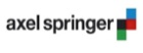
Pivotal Cloud Foundry
Worldwide cross industry adoption
And many more...

Slide 14
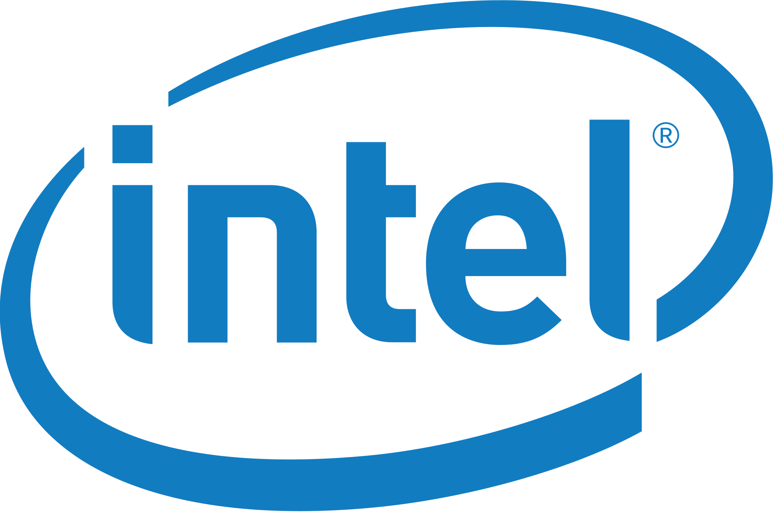
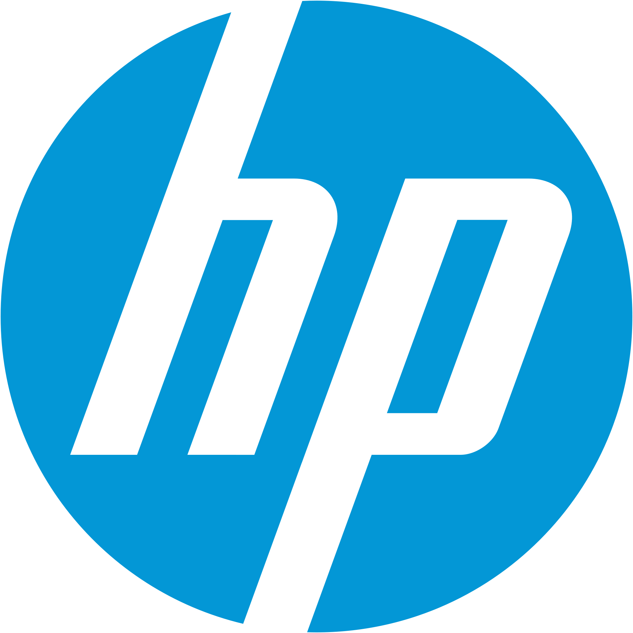
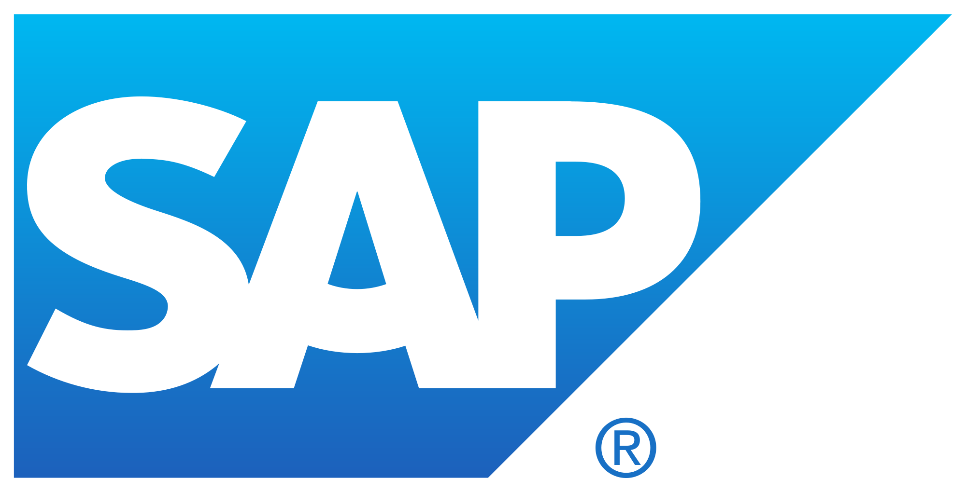

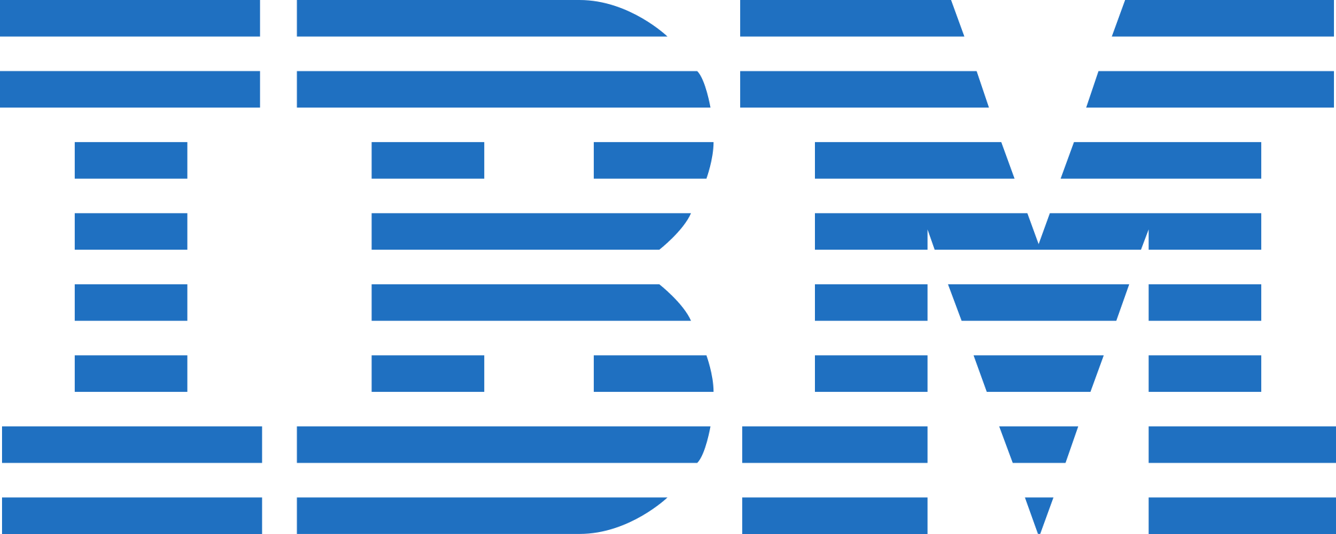


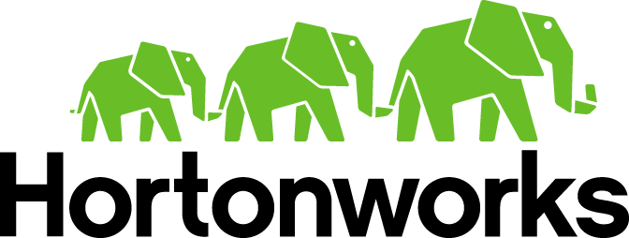
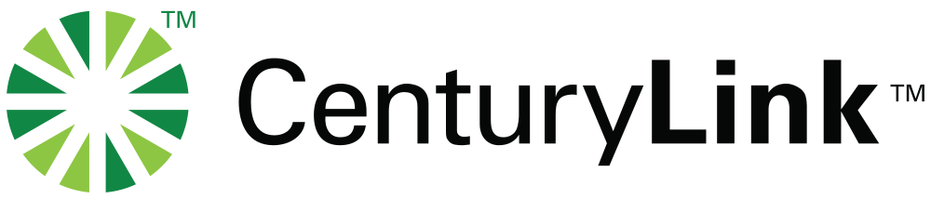
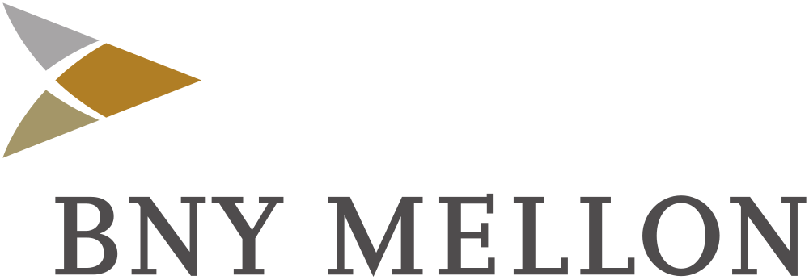

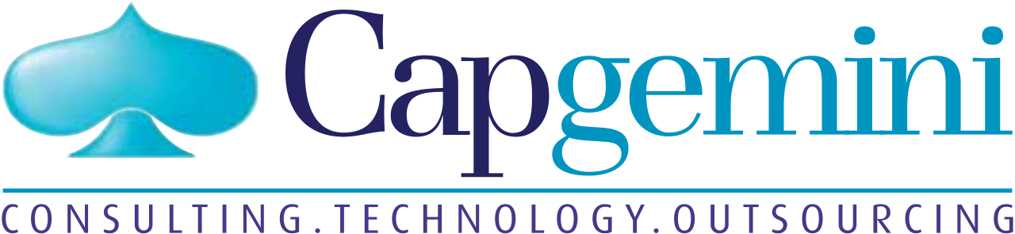

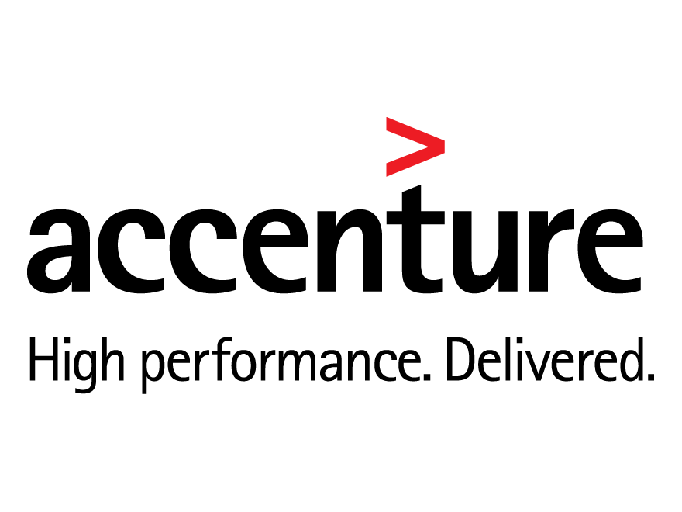

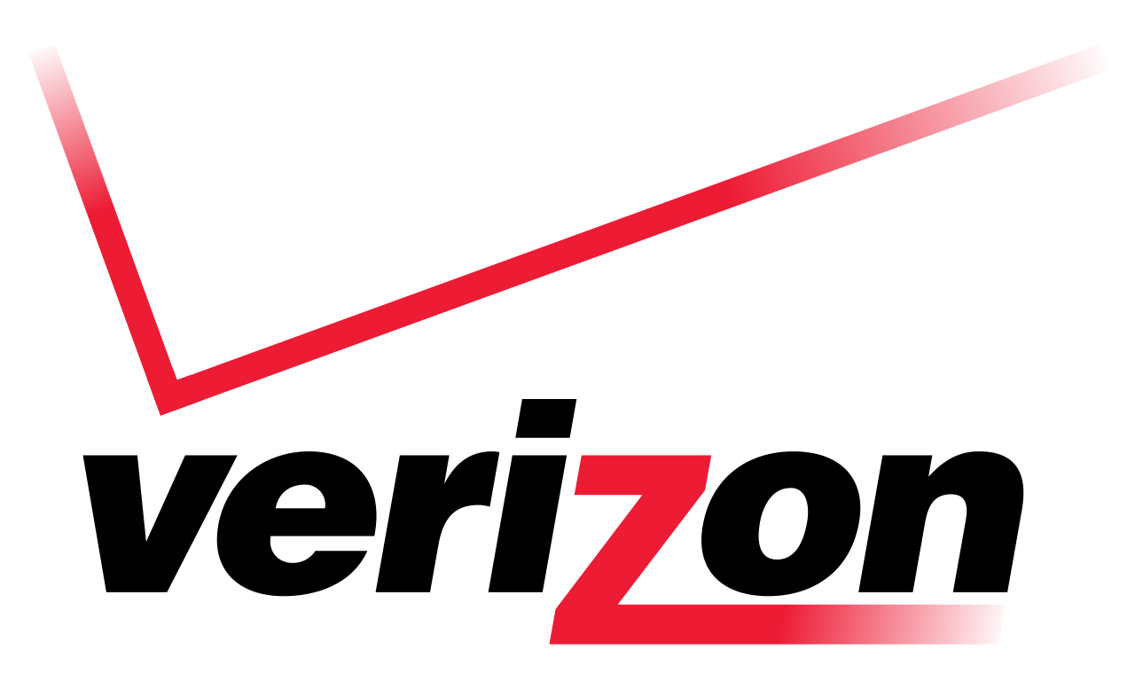

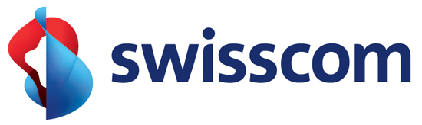

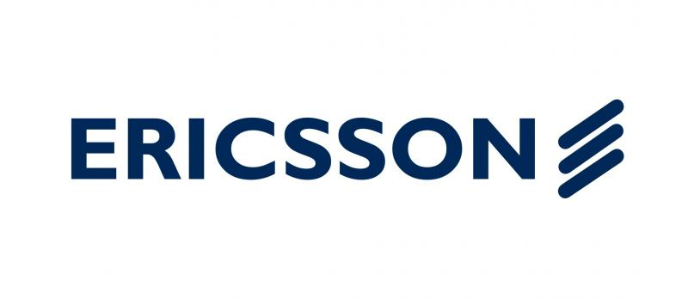
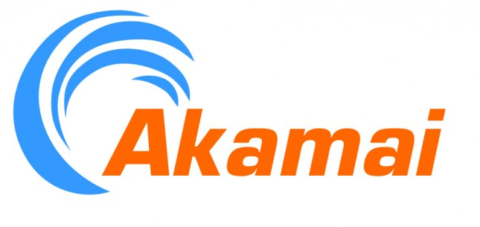
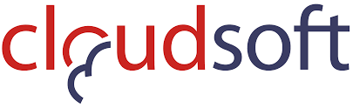
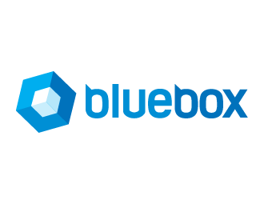

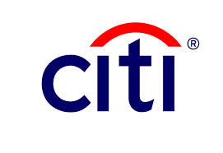
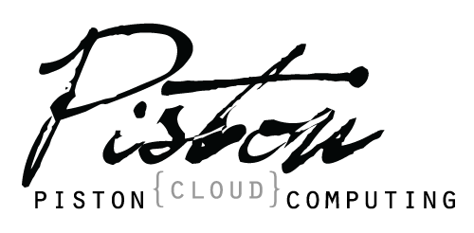
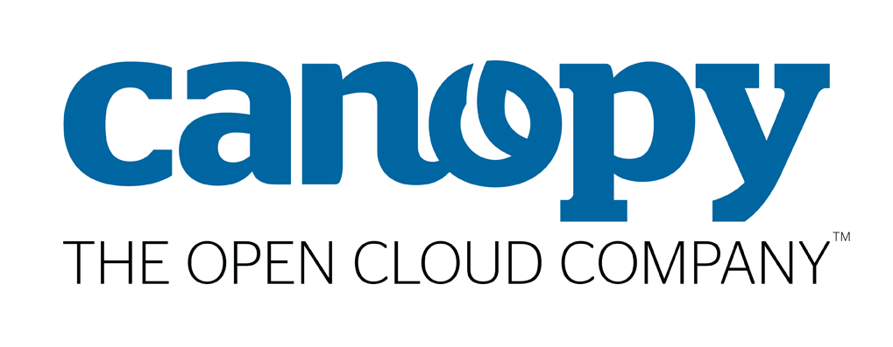
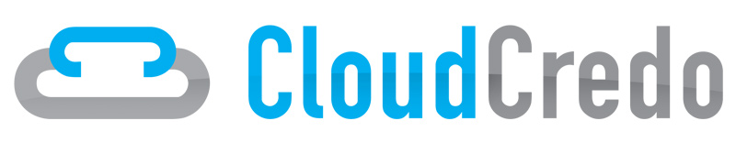
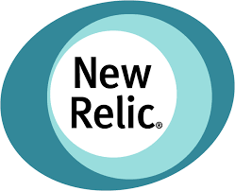

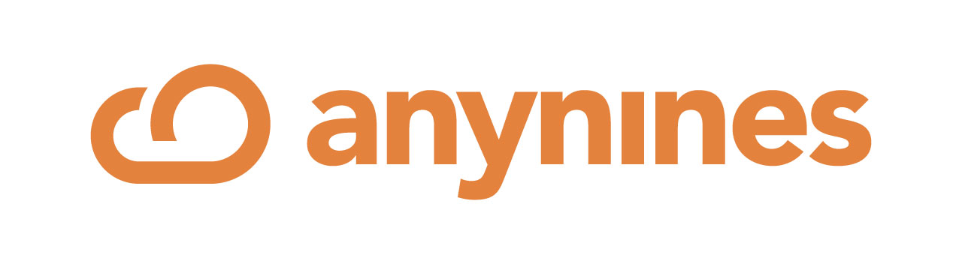

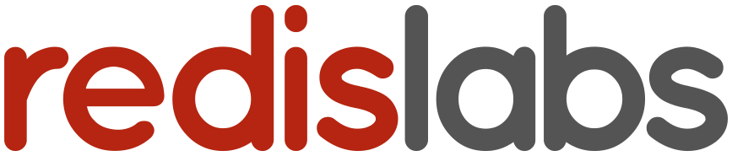

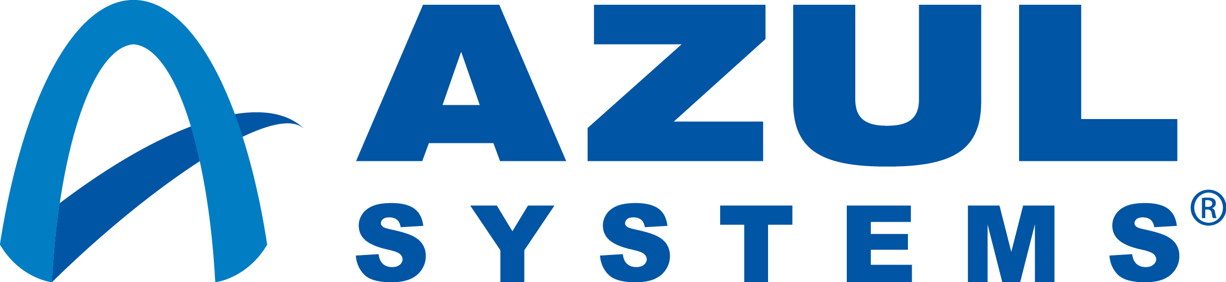
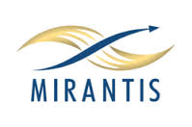
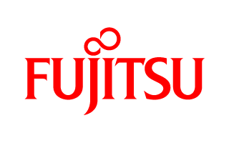

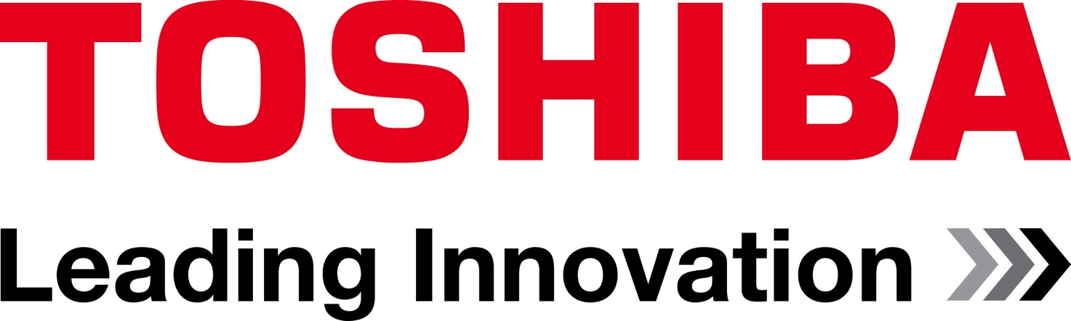

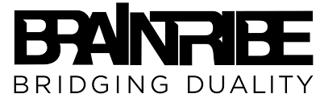
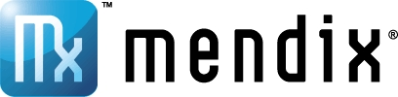

Cloud Foundry Foundation: An Open Industry Standard
PLATINUM
GOLD
SILVER
Notes:
This opinionated design has taken off as an open industry standard. The Cloud Foundry Foundation has more than 50 member organizations, from ecosystem providers like Docker and New Relic to customers making big platform investment like GE, JP Morgan Chase and Verizon.
( Updated Nov 2015, latest foundation slide version is always under https://sites.google.com/a/pivotal.io/inside-pivotal-cf/ )

Slide 15





Pivotal Cloud Foundry at a Glance
Platform Runtime
Services
Routing
Container Scheduling
Service Discovery
Configuration
Database
Application Framework
Big Data
12 Factor Apps
Microservices
RESTful Services
Circuit Breakers
Object Storage
Mobile
Spring Boot
Ruby on Rails
Node.js
.NET
Build CI
User Provided
Logging & Metrics
Messaging
Operations
Zero Downtime Deployments
Failover & Recovery
Scaling
Security Patching
Platform
Upgrades
Azure

Slide 16
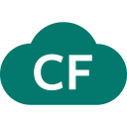



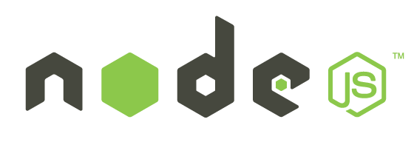
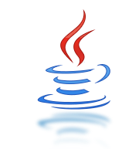
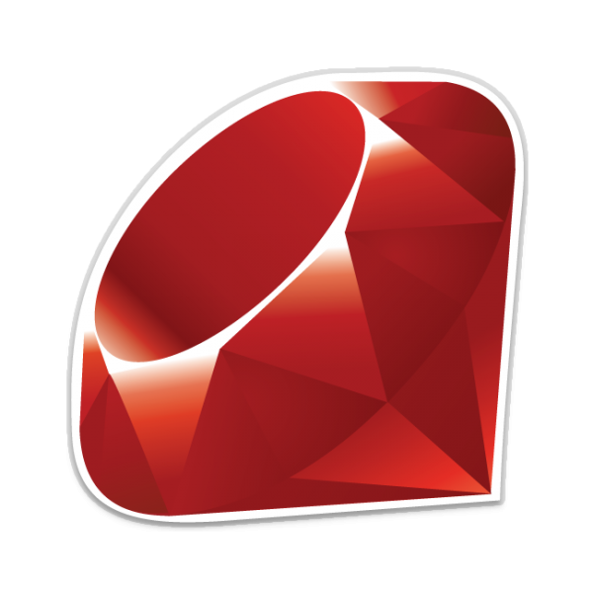
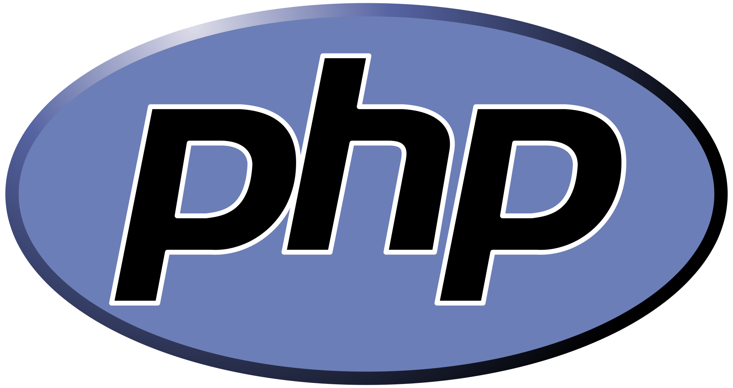




App Modernization & Developer Enablement
more…
Standardized
Dev, Test, and Prod
Environments
Application Monitoring & Logging
Configurable Scaling and Resource Allocation

Slide 17


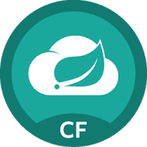



Spring Cloud Services
Rich, production ready library based on Netflix OSS
for cloud native components, security and management.
Cloud
Services
Service
Registry
Config
Server
Circuit
Breaker
core
boot
Dev
Ops + Platform
Notes:
So if you’re interested in incubating microservices, how do you get there? These designs there were until recently, exclusively the domain of the Googles, eBbays, and Twitters, have now gone mainstream. How can you build a microservices application today at your organization? Well, you’ll want to build it using your existing developers' skills.
If you’re a Java shop, there are some great OSS tools available. Spring is #1 Enterprise Java App Dev Framework. Everything is open source.
The Spring Cloud adds distributed system components for configuration management, service discovery, circuit breakers and more.
It’s platform aware and provides an integrated spectrum of opinions. Convention over configuration .
We’ve packaged these components up so your developers can run them on the platform as attachable backing services. It’s built into our Spring Cloud tile.
Finally, Spring Boot adds Rails-like packaging and lightweight app server so your devs

Slide 18

Extensive Services Ecosystem
Core PCF Services
MySQL HA
Redis
RabbitMQ
PHD
Gemfire
Partner Services
Cassandra
Jenkins
GitLab
JFrog
New Relic
StayUp.io ELK
Notes:
Note Cassandra has a lot of momentum at T-Mobile

Slide 19





Enabling Continuous Integration & Delivery
Full application lifecycle management
Build Pipeline Operations
Commit Code Change
Automate Build & Test
(Unit Test, Static Code Analysis)
Store Binaries & Build Artifacts
Automated Integration Testing
Acceptance,Performance & Load
Zero Downtime Upgrade to Production
Tool Chain
Gitlab
Jenkins
Development
Test + UAT + Staging
Production
Distributed revision control and source code management. Collaborative software development.
Build, test and deploy software projects continuously and incrementally. Thousands of compatible plugins.
Share binaries and manage distributions. Manage artifact lifecycle.
Notes:
The integrated approach extends to the Cloud Native Runtime’s integration, with Spring Cloud services being pre-packaged for simple consumption on the platform through our built in marketplace. One leading satellite entertainment provider called this unique blend of microservices supporting features a “no brainer” for their next generation digital services platform. Spring cloud along w/ Spring boot take a developer from idea to a functioning microservice in minutes

Slide 20



Automating Deployments
Notes:
This slide build out the deployment process

Slide 21
Automating Deployments
Here is my source code
Run it on the cloud for me
I do not care how
Notes:
Alt version of previous: This slide build out the deployment process

Slide 22


Full Stack Ticket Elimination
Firewall & Routes
Service Bindings
App Lifecycle
Runtime Installation & Config
Middleware Installation & Config
Application Installation & Config
App Lifecycle
Logging, Health, Telemetry

Slide 23
Full Stack Ticket Elimination
Firewall & Routes
Service Bindings
App Lifecycle
Runtime Installation & Config
Middleware Installation & Config
Application Installation & Config
App Lifecycle
Logging, Health, Telemetry
Notes:
This slide builds out the typed of eliminated tickets

Slide 24

Multi-cloud Portability
A single, consistent deployment environment across your public cloud and behind-the-firewall datacenters.
Azure

Slide 25












Capabilities of Pivotal Cloud Foundry
Automatic App Server & OS Configuration with Buildpacks (“just push your app”)
Application
Containerization & Cluster Scheduling
Application Network Security Groups
Application to Services Binding and Access
App Health,
Load Balancing,
Rapid Scaling, Availability Zones
Policy, Identity and Roles Management
Logging as a service,
Application metrics & performance,
Metric based scaling
Native & Extended Data, Mobile and Platform Services
IaaS Provisioning, Scaling & Configuration
Deploy, Operate, Update & Scale with minimal downtime on choice of IaaS
Azure
Notes:
Key Platform Capabilities
On Demand Scaling
Application Health Management
Dynamic Routing & Load Balancing
Log and Metric Aggregation
Security
WHAT
Pivotal CF is next generation middleware that delivers 9 things that are typically delivered via point software products.
We provision operating systems and middleware.
We deliver workload density without compromising application performance.
We ensure that applications have appropriate network security safe guards to prevent security threats.
We support application connections to external sources including databases and legacy middleware.
We provide 4 levels of HA, with built in load balancing for scale in/out
We support multi-tenant environments so that each line of business can operate with a discrete quota and isolated system access.
We provision next generation data services including NOSQL databases, traditional databases and hadoop clusters.
We provide horizontal and vertical scaling for the underlying IaaS so that you can scale your infrastructure in lock step with your Business.
We provide a built-in log aggregation service, built-in APM metrics and utilization based auto-scaling so that you can monitor the health of your applications and scale out without human or 3rd party tool intervention.
I am going to cover each of these 9 capabilities in more detail, but it’s important to note the impact of this collection of capabilities. The following slides will include information on CAPEX and OPEX reduction. We will also discuss how you can deliver faster time to value while holding the line on infrastructure cost.

Slide 26








Pivotal Cloud Foundry High Level Architecture
The Cloud Foundry platform is abstracted as a set of large-scale distributed services. It uses Bosh to operate the underlying infrastructure from IaaS providers (e.g., VMware, Amazon AWS, OpenStack).
Service Broker(s) – Bind internal/external Services to Applications
CELL – Secure and fully isolated containers responsible for an App’s lifecycle: building, starting and stopping Apps as instructed.
Pivotal CF Elastic Runtime
Dynamic Router
ROUTING
OAuth 2.0 Server (UAA)
Login Server
AUTHENTICATION
CC & CC Bridge
BBS
Converger
APP LIFECYCLE
BBS/etcd
MESSAGING
Service Brokers
CELL
Blob Store
APP STORAGE
& EXECUTION
Garden
Build Packs
Sys Log
Collector
App Log
METRICS & LOGGING
Pivotal CF OpsManager/BOSH
Azure

